Slide 1

Job portal data Project 2 Oeson
By Michael Rantisi

Slide 2

content
Project Description
Data visualization
Conclusion

Slide 3
Project description
You are given the dataset extracted from a famous job portal that explains the job status of various data-related jobs posted during the year 2023. The data explains the various job designations and related salaries from across the world. As a data scientist at Oeson, your job is to extract meaningful insight from this data to explain the actual remuneration each job title is providing across the globe. It will help recruiters understand the job requirements better in term
salaries across different levels of work experience so that they can get proficient profiles for any data-related requirement

Slide 4
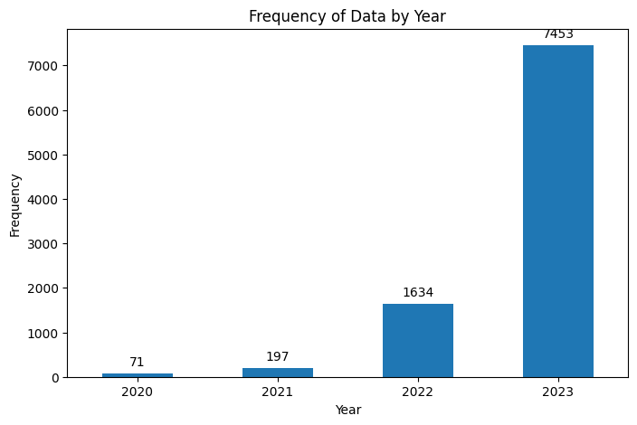
Frequency of the data for each year
We can notice that the data frequency
Is mainly fixated around the year 2023
With an overall frequency result of 7453
With the year 2020 being the least at
71 frequency.
Overall, this tells us that the frequency
In our project is new and UpToDate

Slide 5
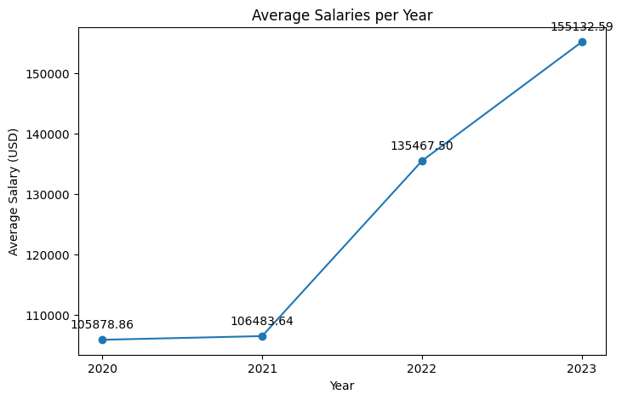
Average salaries for each of the years
We can deduce that there is a Positive correlation between the year and average salary as 2020 is the lowest at 106k but increases each year to reach 155k with jump in salary average of 49k

Slide 6
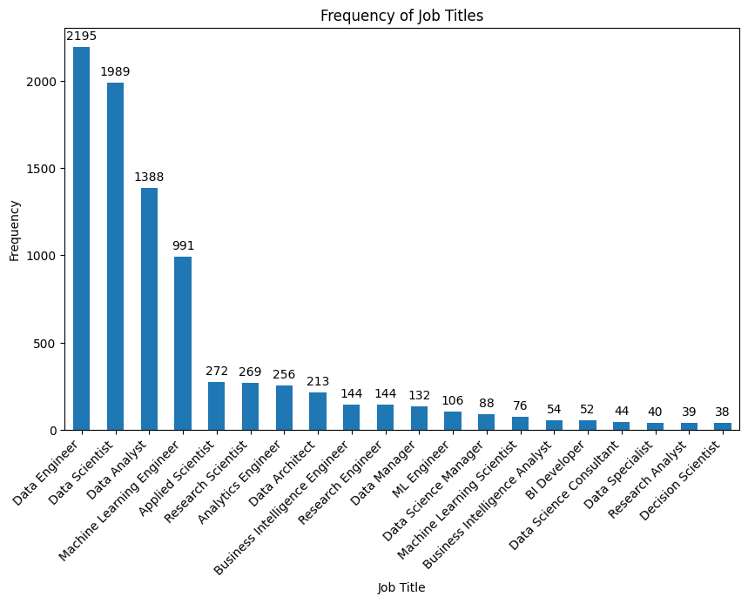
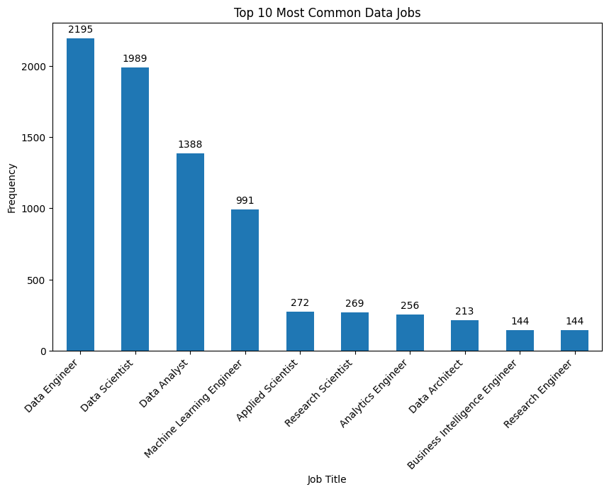
Frequency of Job Titles and most common data jobs
We can see from both plots that jobs that are the most acquired are Data - Engineer/Scientist with Engineering being the highest at 2195 frequency
reflecting the high demand and centrality of these roles in the data industry

Slide 7
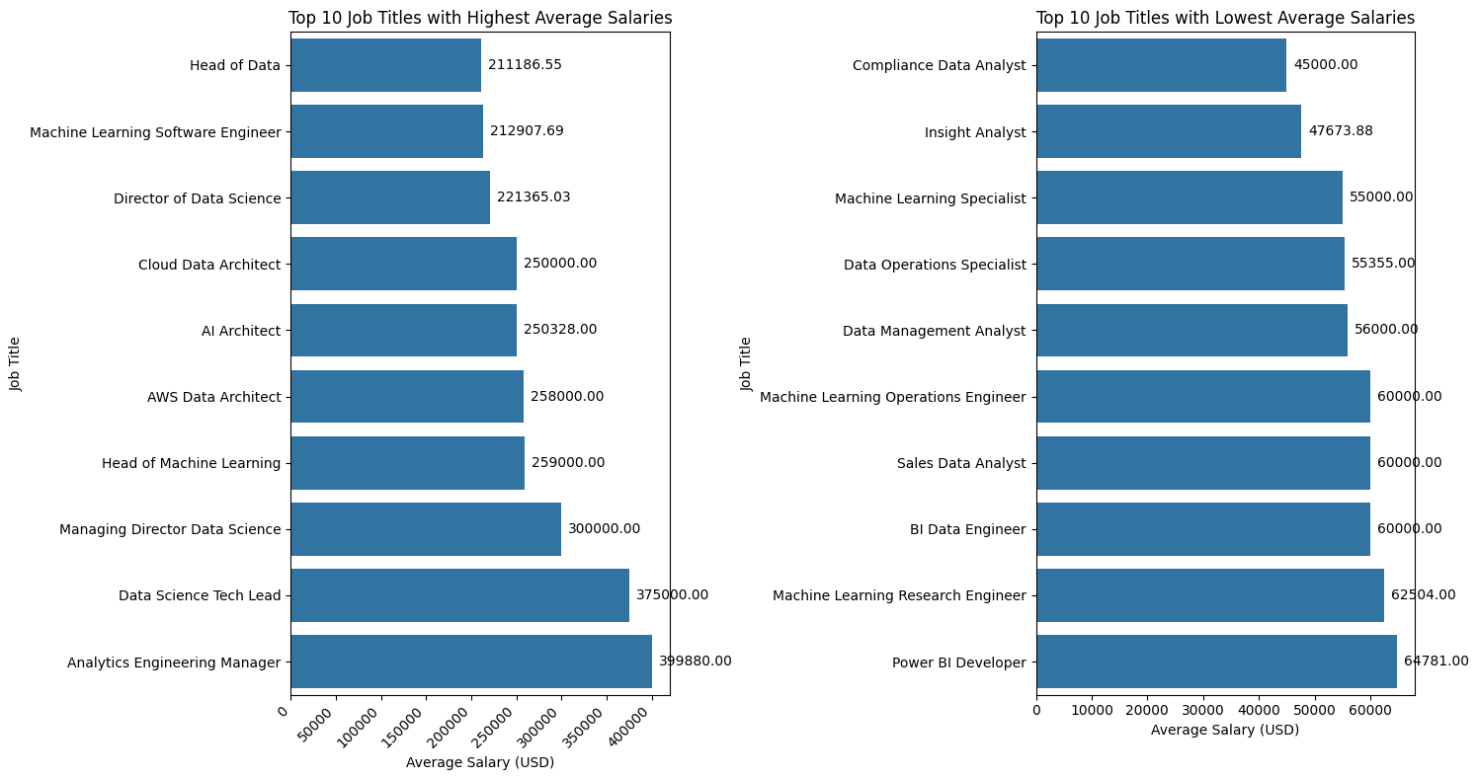
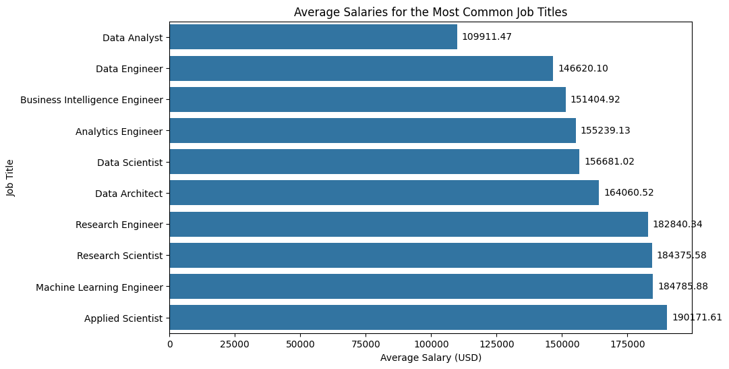
Average Salaries for Job Titles and most common
From these two comparative plots we can deduce the highest annual average salary with analytics engineering manager being the highest while the lowest annual average salary could be seen to be compliance Data Analyst
From the most common job titles plot we can understand that applied scientist gets paid the highest at 190k annual while the data analyst being the least paid in the top 10 most common jobs at 109k

Slide 8
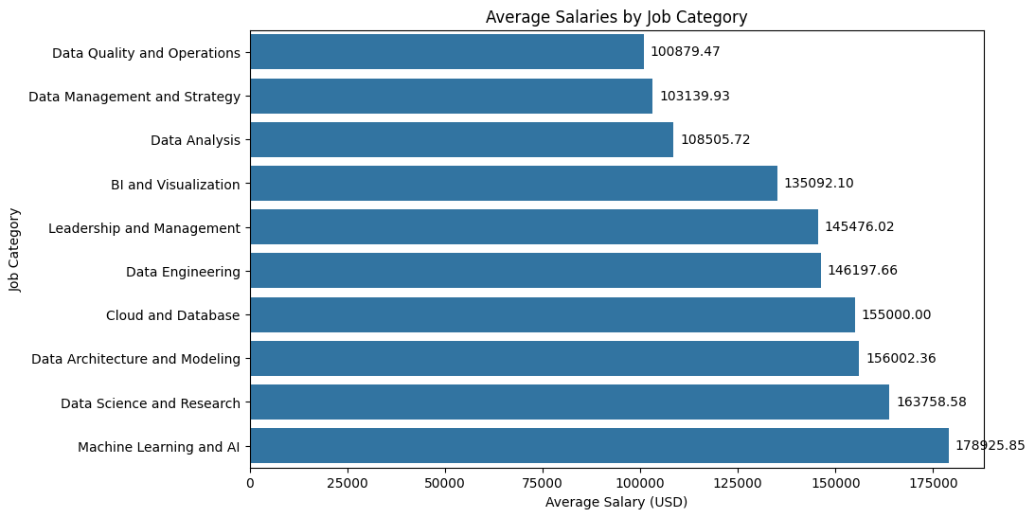
Average salary by job category
From generated plot we can see that machine learning and AI take the first place as the highest average Salaries by job category at 179k while Data Quality and Operations is the lowest at 101k

Slide 9
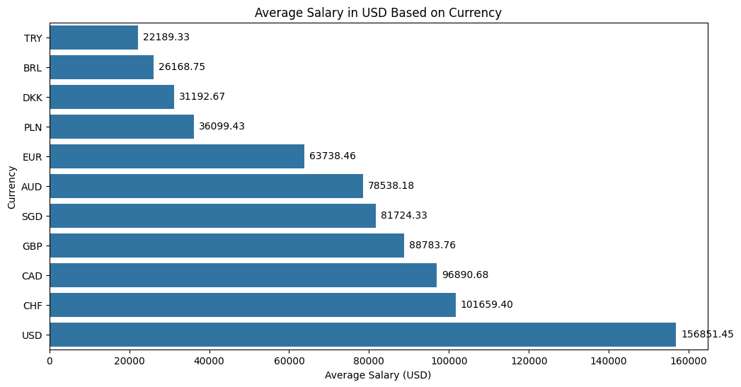
Average salary in USD based on currency
From this plot chart we can deduce that the USD is the highest based on currency while TRY is the lowest on that scale with 22k average salary which is 134k less than the average salary in USD

Slide 10
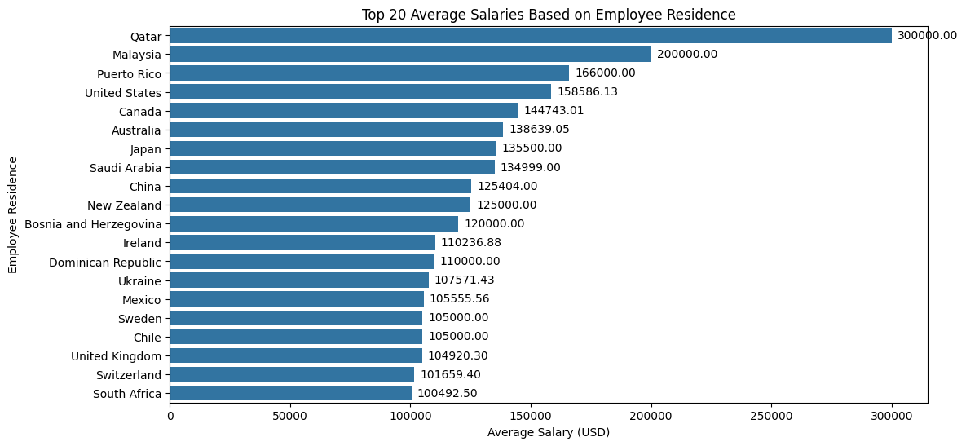
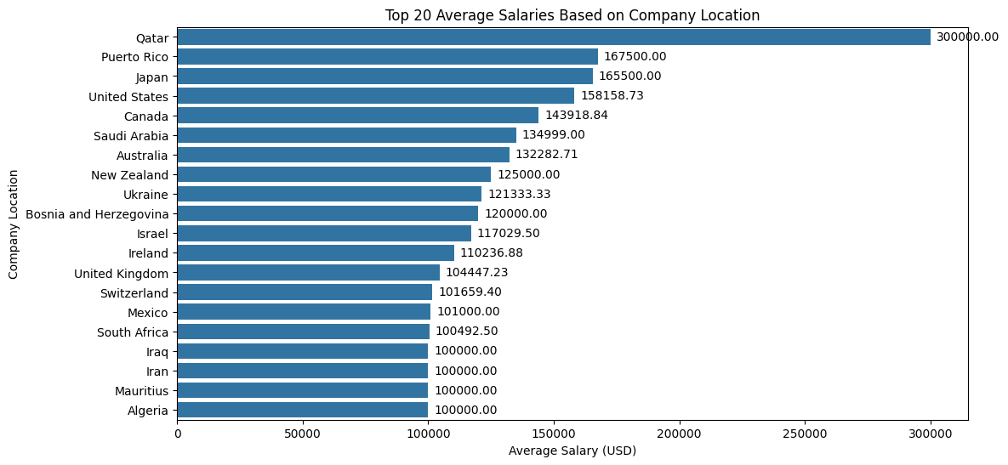
Average salary based on residency of employees and company location
We can see a general trend that in both factors Qatar average salary is the highest at 300k but the rest of the countries vary and we can deduce as well that Qatar’s average salary 3x the lowest in both factors for the top 20 countries for both factors making it the best place to work for the factor of salary

Slide 11
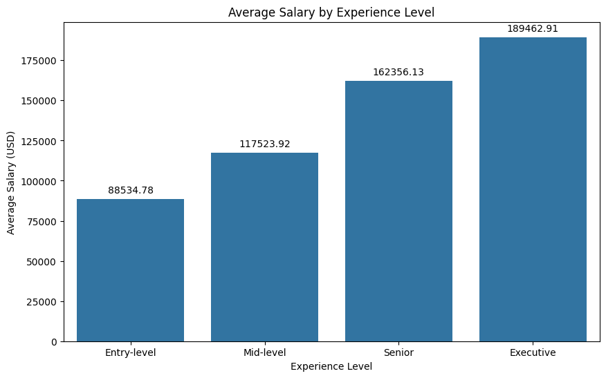
Average salary by experience
This plot shows a positive correlation between the experience level and average salary as the experience level increases the average salary increases gradually seen from the entry level being at 86k avg while at the executive level is 189k

Slide 12
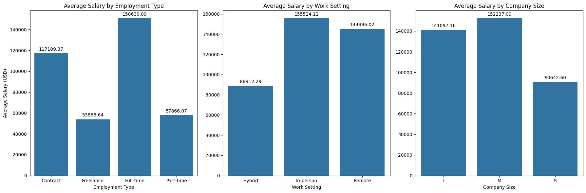
Average Salary Based on Employment Type, Work Setting and Company Size
From these different plots we can deduce the following:
Different employment types (Full-time, Part-time, Contract) show variations in average salaries, reflecting the differing nature of employment agreements.
The work setting (Remote, In-person, Hybrid) also influences salaries, although the exact nature of this influence might be nuanced and dependent on the specific job and industry context.
Company size shows a correlation with average salary, suggesting that larger companies may offer higher compensation, possibly due to greater resources and scalability.

Slide 13
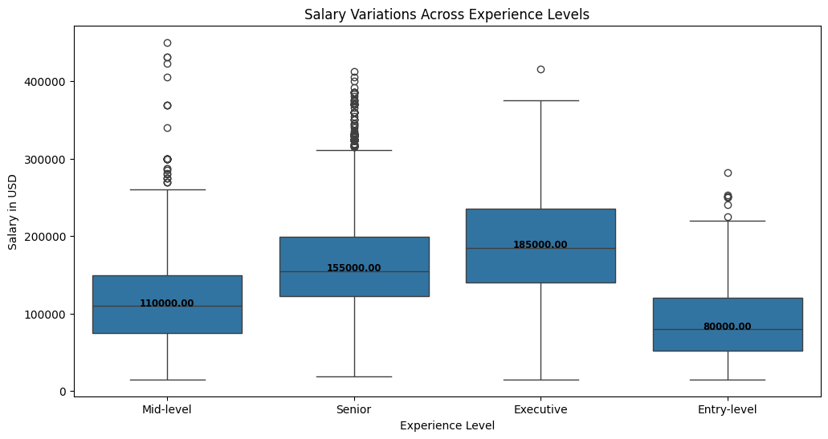
salary Variations across experience levels
The box plot demonstrates a clear progression in salary levels as experience increases, which is consistent with market expectations that reward experience and seniority.
The number of outliers at the senior and executive levels suggests that there may be potential for high earnings growth in these career stages, depending on individual performance, negotiation skills, and the specific employer.
For all experience levels, the bottom of the box (the 25th percentile) is quite distinct from the top (the 75th percentile), especially at senior and executive levels, indicating a broad salary range within each category.

Slide 14
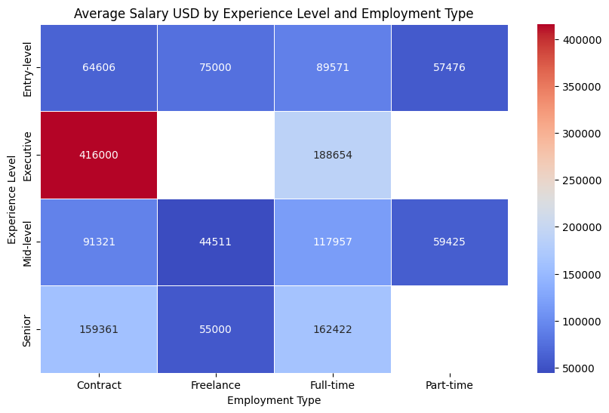
Average salary by experience and employment
There is a clear trend where average salaries increase with higher experience levels across all employment types, which underscores the value of experience in the data industry.
Contract roles generally offer higher average salaries than full-time roles at the executive level, while full-time roles seem to provide better compensation at the senior level.

Slide 15
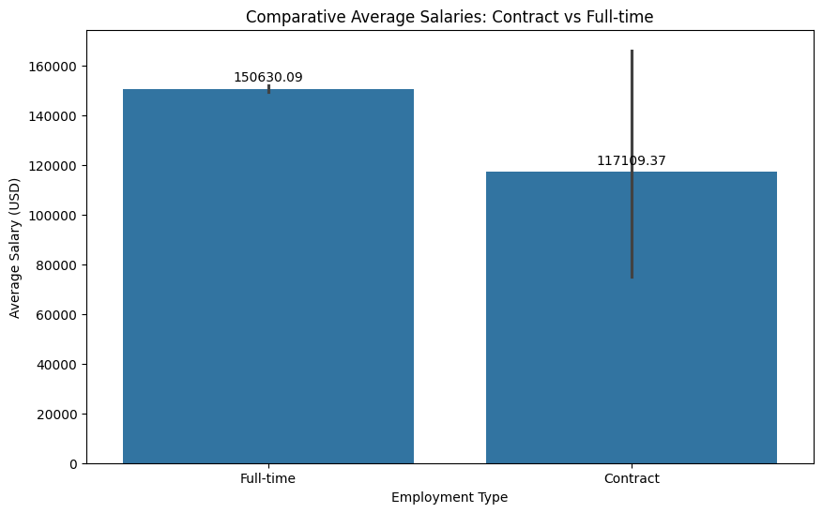
Average salaries for contracts vs full time
The bar chart shows that full-time employees have a higher average salary of approximately $150,630 compared to contract employees, who have an average salary of around $117,190. This indicates that full-time positions tend to offer better compensation than contract positions in the data job market. The error bar on the Contract employment bar suggests more variability in contract salaries than full-time salaries. Overall, the chart illustrates a clear distinction in compensation between these two types of employment.

Slide 16
Conclusion
Overall, the project reveals key trends in the data job market: a growing demand for data roles is driving up salaries, especially in specialized positions like Analytics Engineering and AI. Geographic location, currency, and company size significantly impact salary variations, emphasizing the role of regional market dynamics. A strong correlation exists between higher experience levels and increased compensation, highlighting the value of expertise in the industry. Additionally, full-time roles typically offer better remuneration compared to contract positions. These insights collectively paint a picture of a dynamic and evolving data job market, where specialized skills, experience, and geographical factors play crucial roles in determining salaries.

Slide 17
GitHub link
https://github.com/michaelrantisi/Project-2

